Slide 1
Introduction to Robotics Course no. 2
Andrei Dumitriu
andrei.dumitriu@fmi.unibuc.ro
Faculty of Mathematics and Computer Science
University of Bucharest

Slide 2
Today’s plan
Arduino Uno - a closer look
Arduino, ATMEGA
Signal: Analog and Digital
analogRead, analogWrite, digitalRead, digitalWrite
PWM
Low pass filter
Timers: delay() vs millis()
Coding style

Slide 3
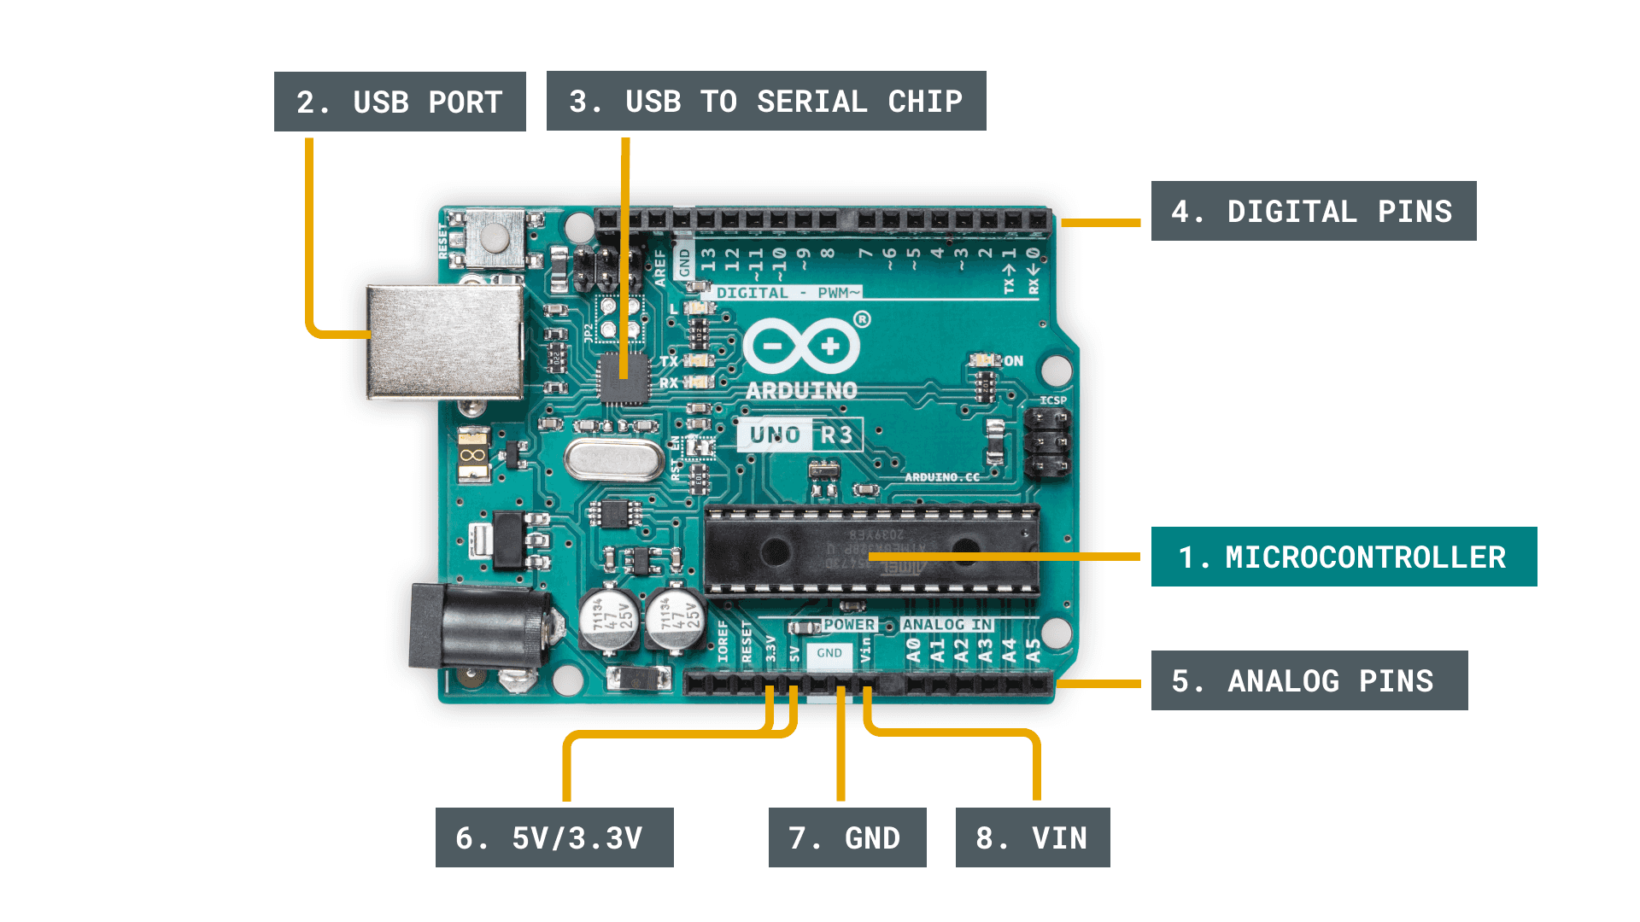
Arduino Uno board

Slide 4
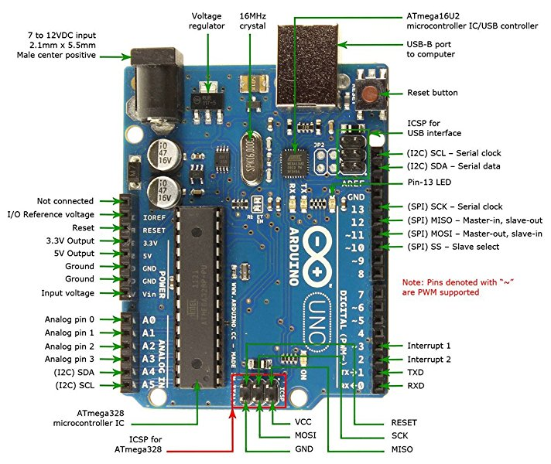
Arduino Uno board

Slide 5
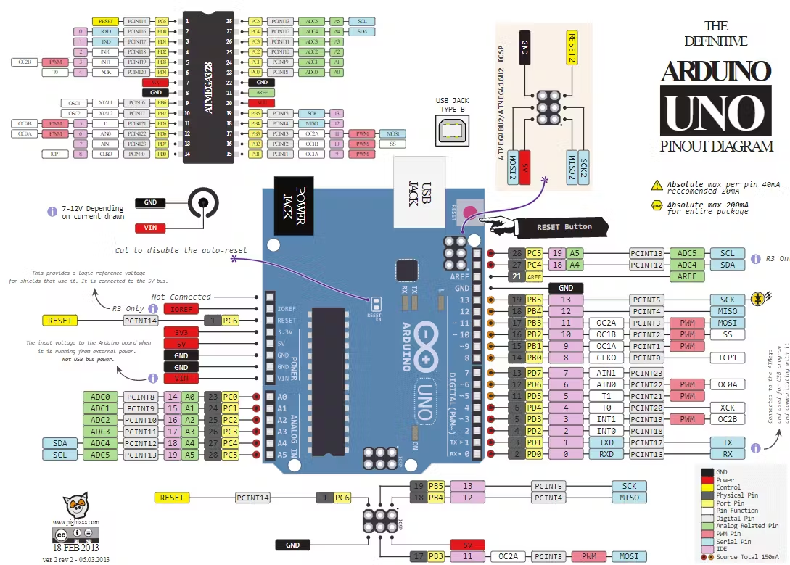
Arduino Uno board

Slide 6
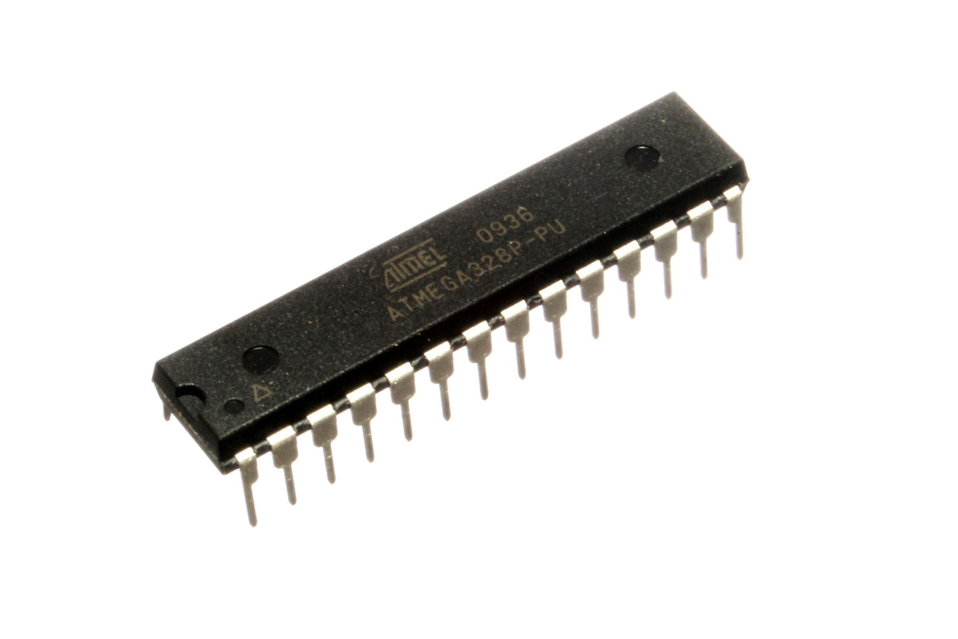
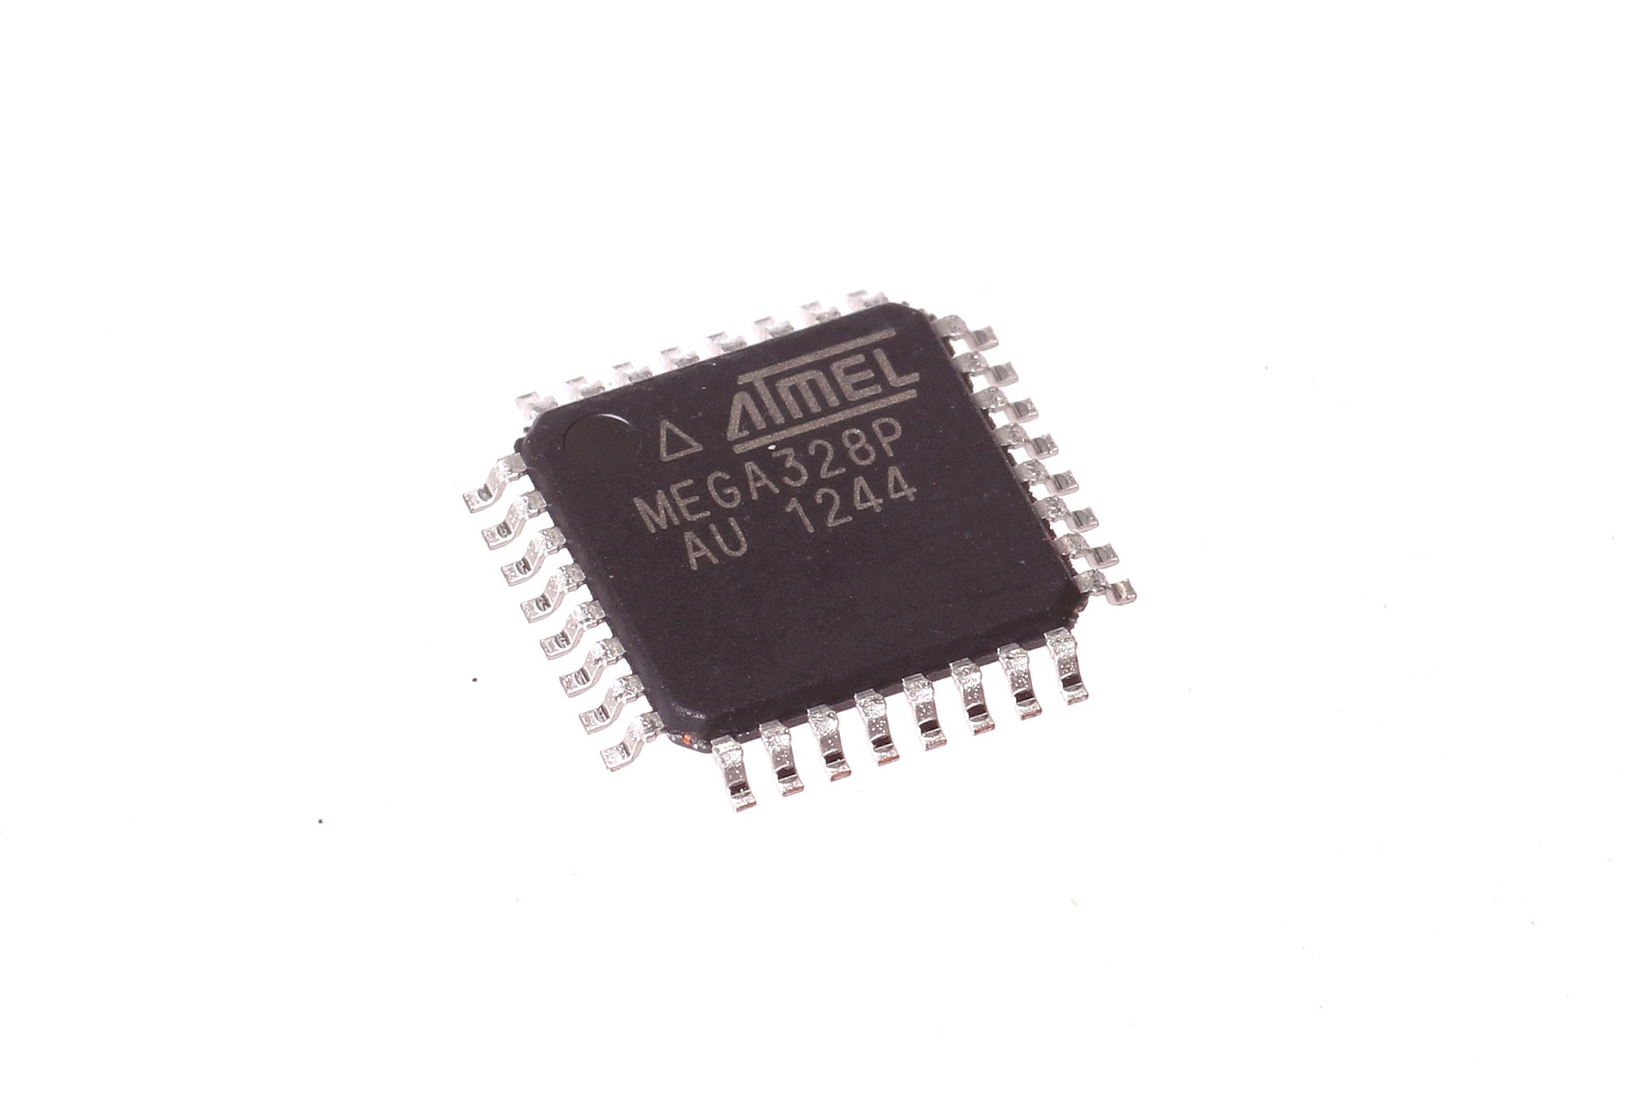
Atmega328
https://web.mit.edu/6.111/volume2/www/f2018/handouts/ATmega328P.pdf

Slide 7
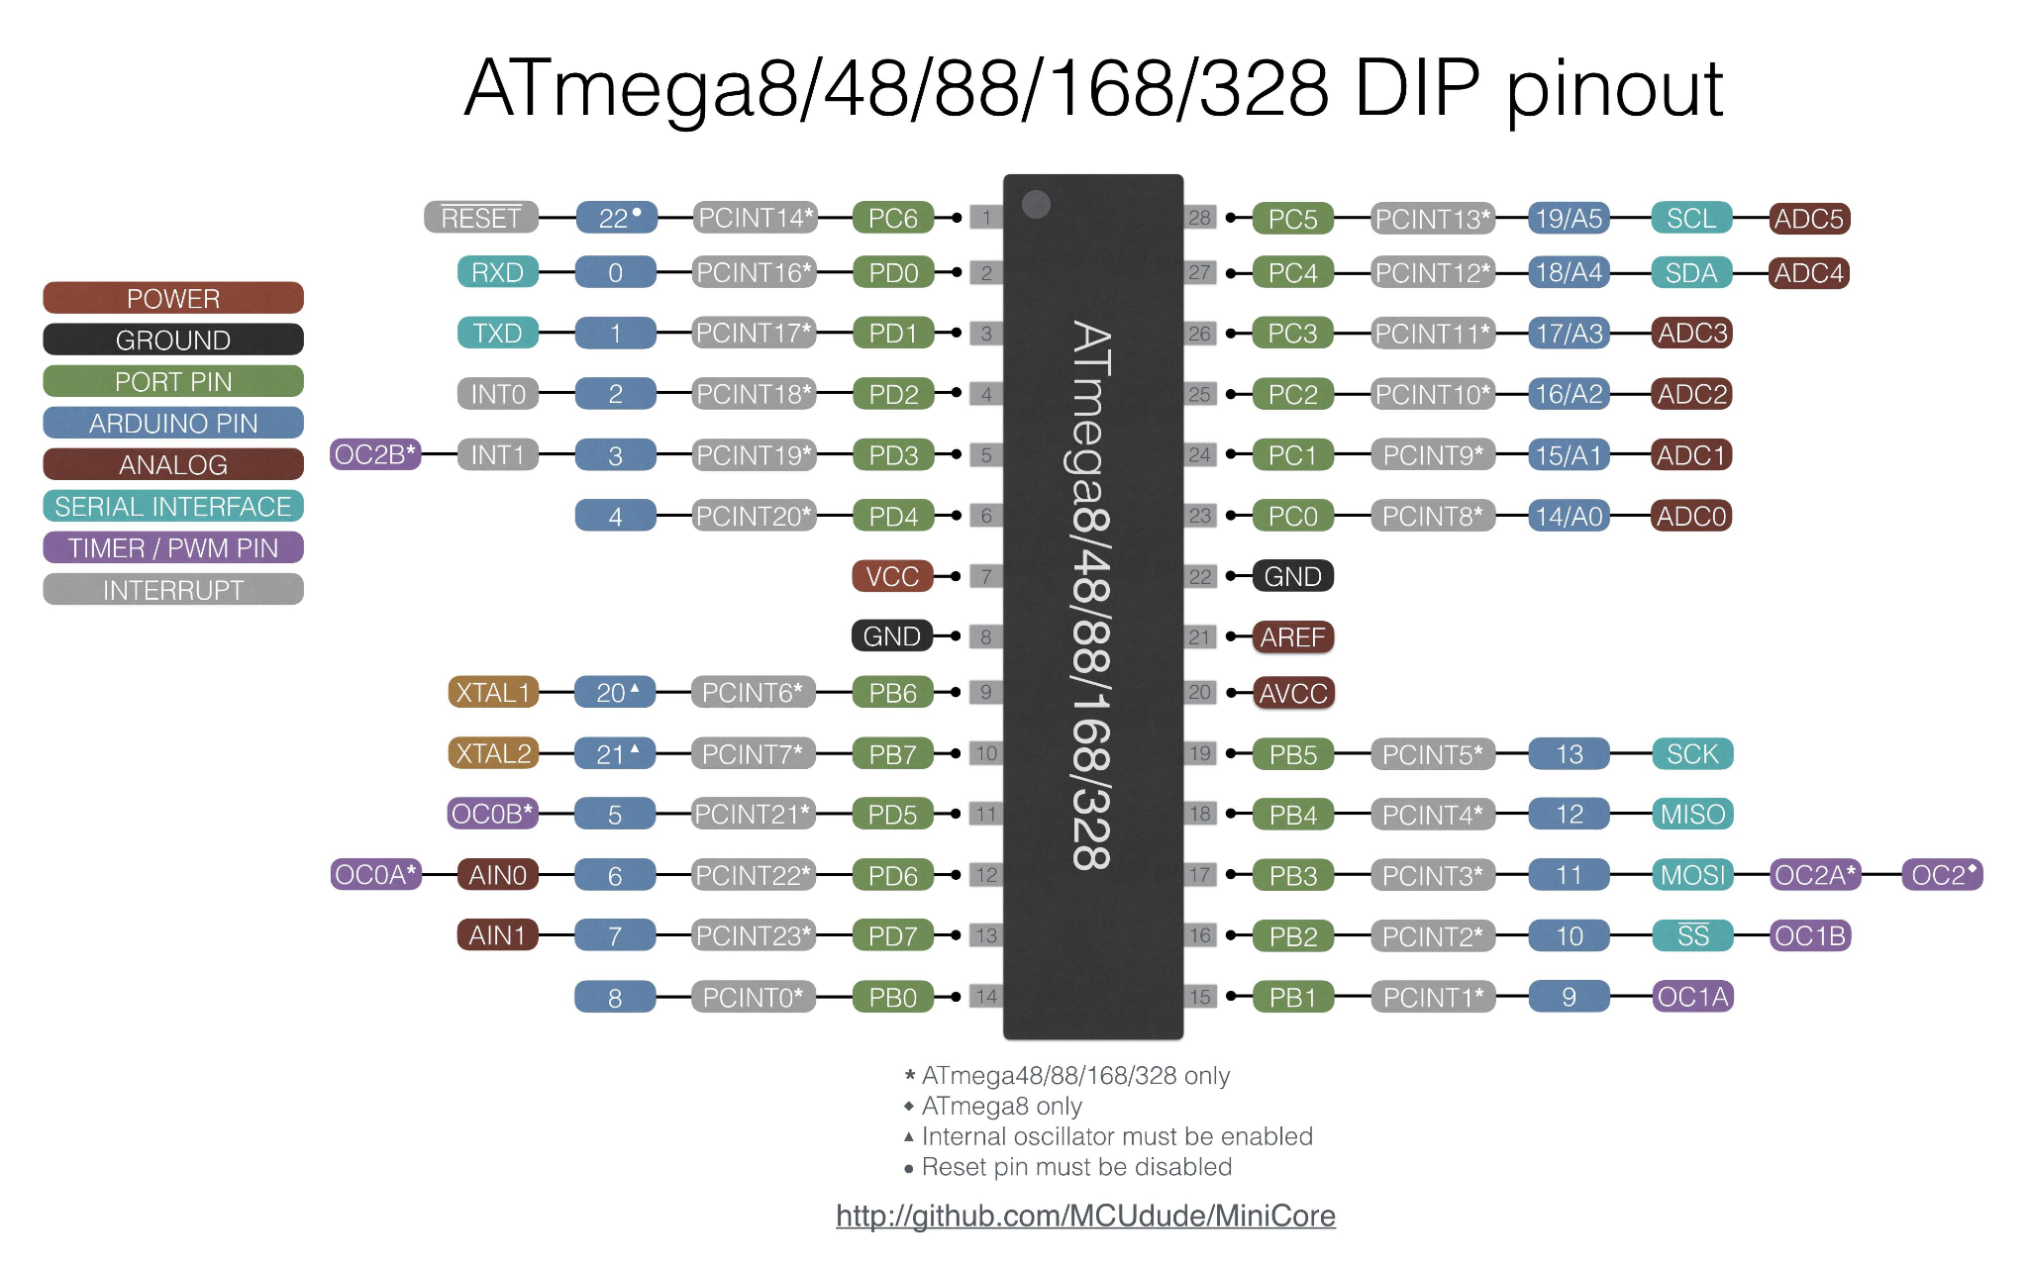
Atmega328
https://web.mit.edu/6.111/volume2/www/f2018/handouts/ATmega328P.pdf

Slide 8
Atmega328
Atmel 8-bit AVR RISC-based Microcontroller Features:
Memory & Storage:
32 KB ISP flash (read-while-write)
1 KB EEPROM
2 KB SRAM
I/O & Registers:
23 general-purpose I/O lines
32 general-purpose registers
Timers & Interrupts:
3 timer/counters (flexible compare modes)
Internal & external interrupts
Communication:
USART (serial programmable)
2-wire serial interface
SPI serial port
Converters & Other Features:
6-channel 10-bit A/D converter (8 in TQFP & QFN/MLF)
Programmable watchdog timer (internal oscillator)
Power & Voltage:
1.8 to 5.5 volts operation
5 power-saving modes

Slide 9
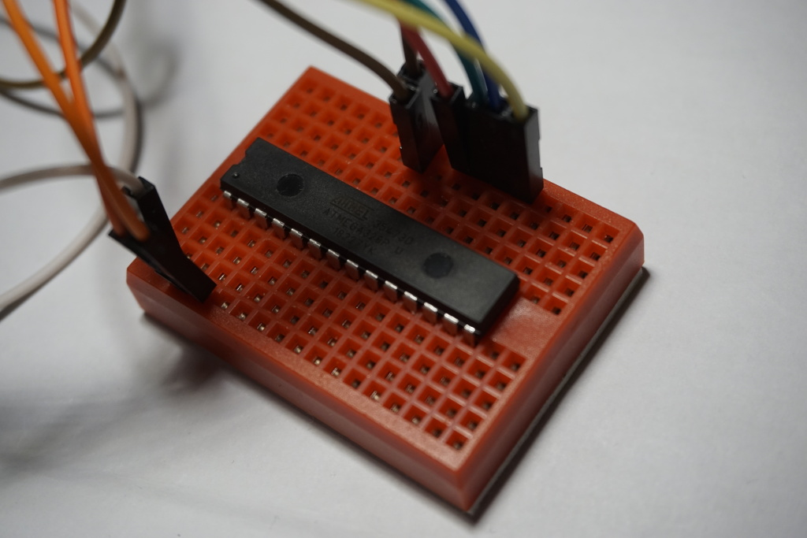
Atmega328
https://web.mit.edu/6.111/volume2/www/f2018/handouts/ATmega328P.pdf

Slide 10
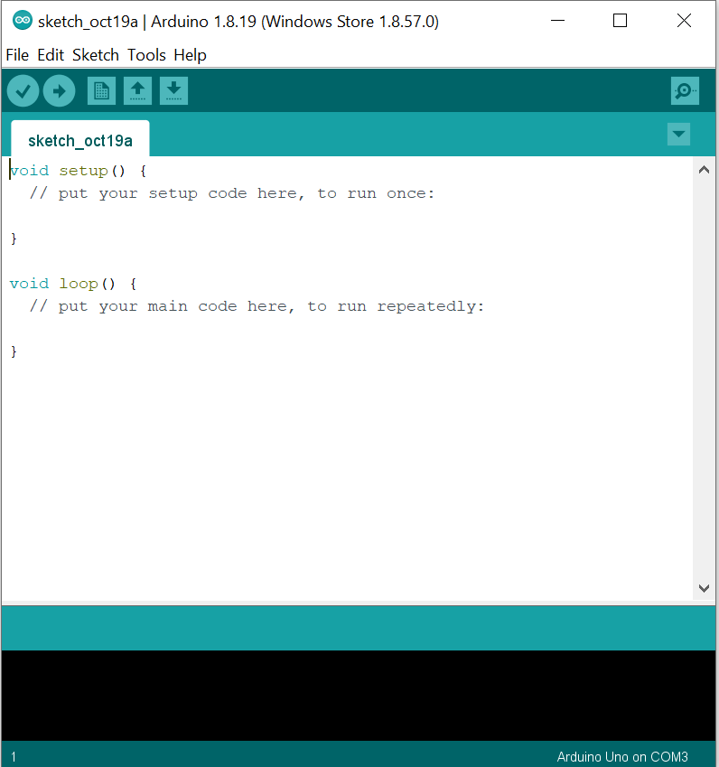
Arduino IDE

Slide 11
Basic functions
analogRead(): Read the value from an analog pin.
analogWrite(): Output a PWM signal.
digitalRead(): Read the value from a digital pin.
digitalWrite(): Set a digital pin to HIGH or LOW.
pinMode(): configure the pin as either INPUT or OUTPUT

Slide 12
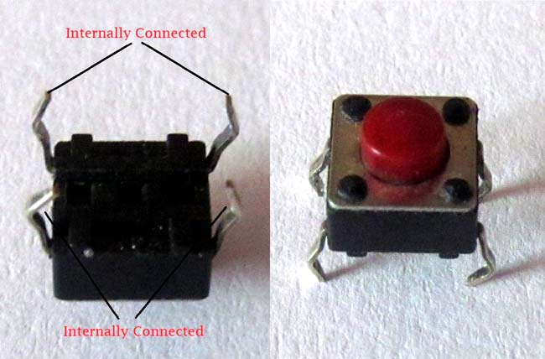
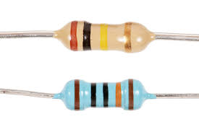
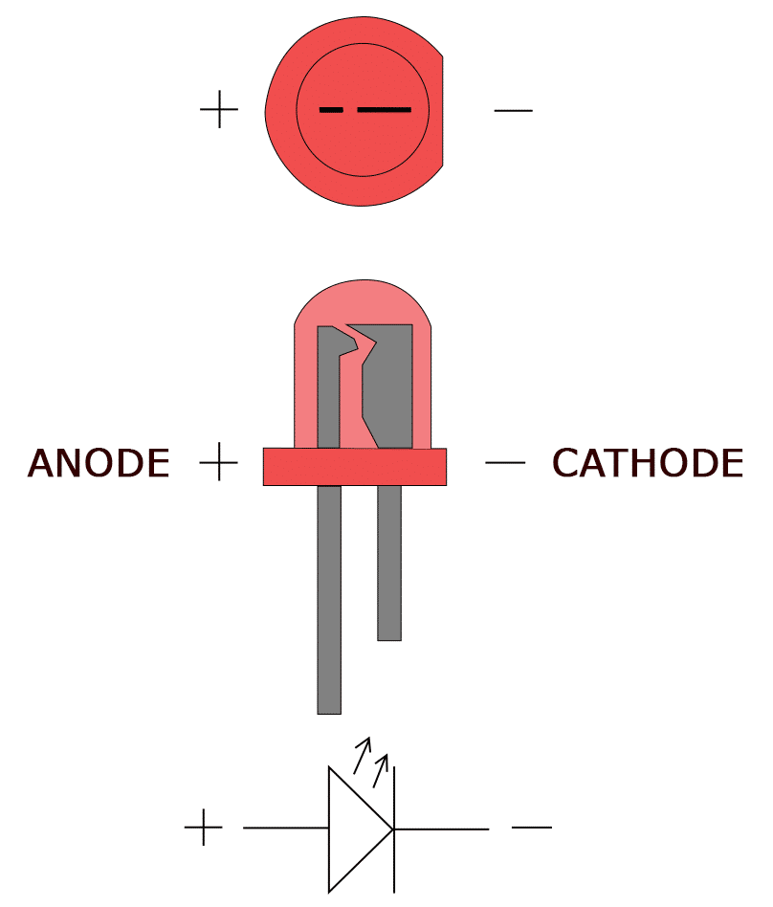
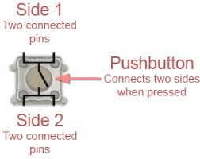
Simple electronic components
LED Push button Resistor
Resistors are electrical components used to limit current in a circuit. They are passive components, meaning they only consume power (and can't generate it). The resistor's resistance limits the flow of electrons through a circuit.

Slide 13
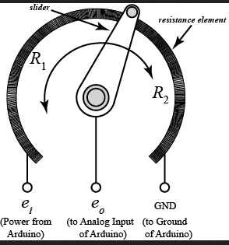
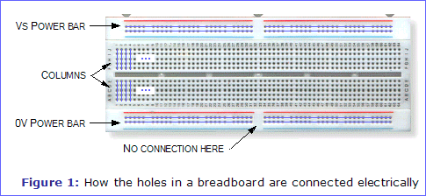
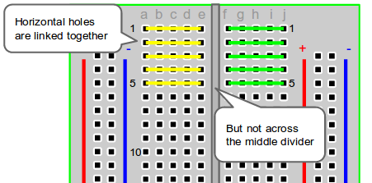
Simple electronic components
Breadboard Potentiometer
A potentiometer is a simple knob that provides a variable resistance, which we can read into the Arduino board as an analog value.

Slide 14
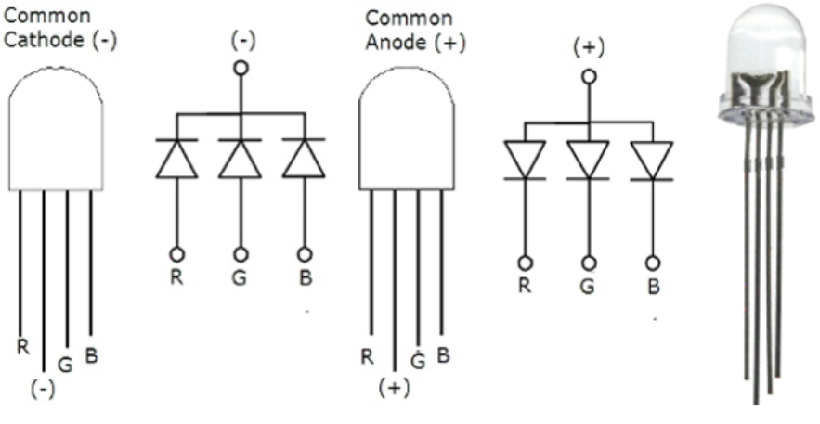
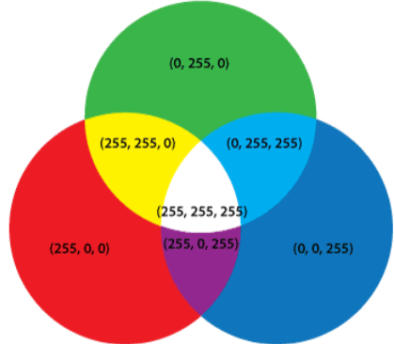
RGB LED
Have three tiny LEDs of 3 primary colors (red, green and blue) where a terminal is common for all
Detailed guide on common anode vs common cathode rgb LED

Slide 15
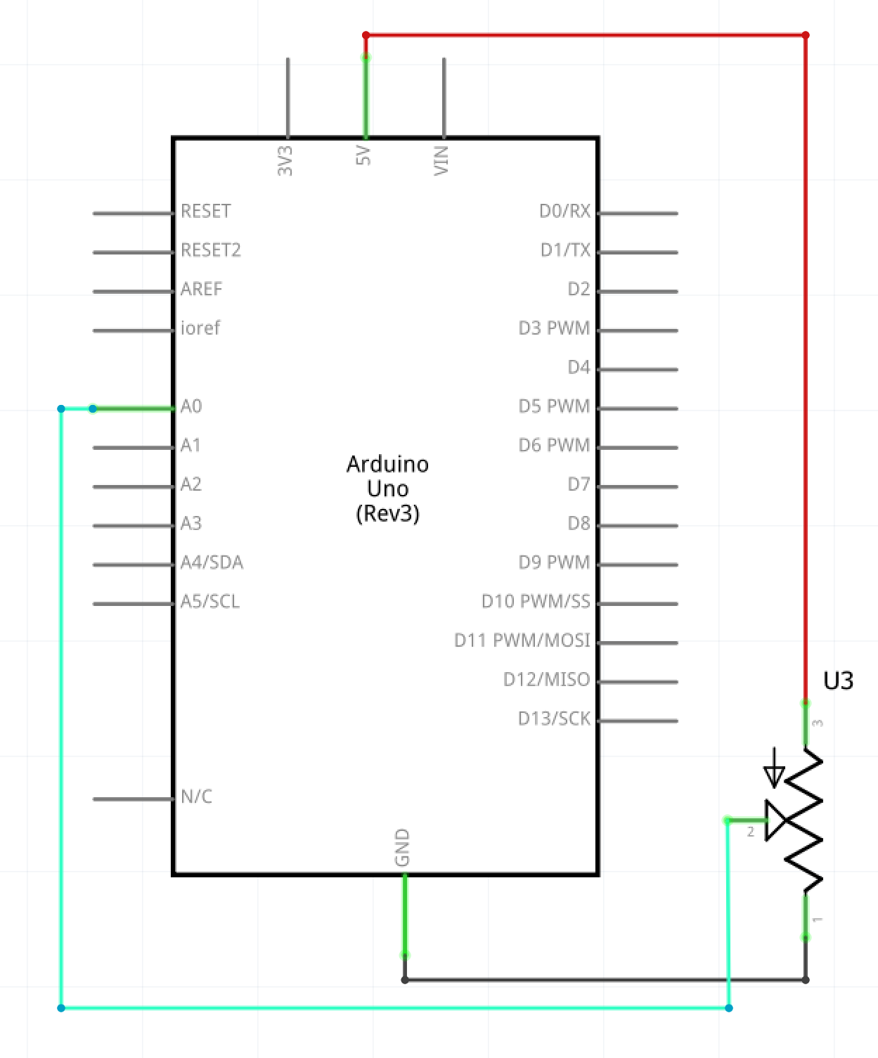
Simple electronic components

Slide 16
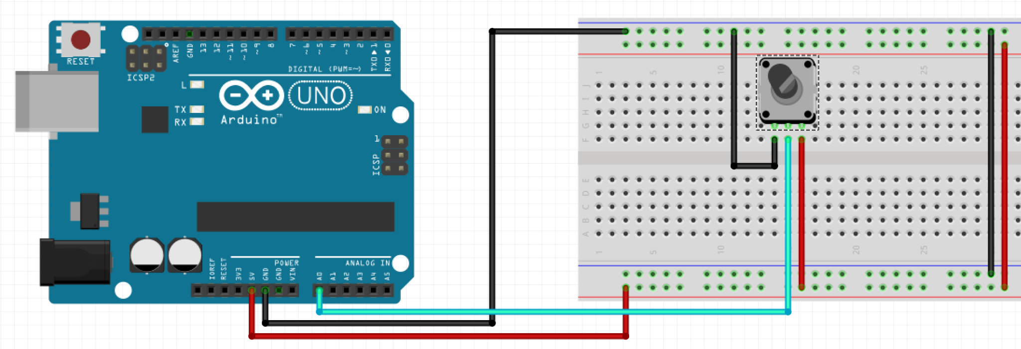
Simple electronic components

Slide 17
Simple electronic components

Slide 18
Color Coding
When possible, follow the wires color scheme:
BLACK for GND (dark colors if not available)
RED for POWER (3.3V / 5V / VIN) (bright colors if not available)
Bright Colored for read and write signal (use red when none available and black only as a last option)
We know it is not always possible to respect this due to lack of wires, but the first rule is NOT USE BLACK FOR POWER OR RED FOR GND!

Slide 19
Point of view - Signal
A signal might have 2 interpretations:
input
it gives information to the system
it is commonly called a reading
output
it gives information to the outside of the system
These interpretations can also be of 2 types:
digital
analog

Slide 20
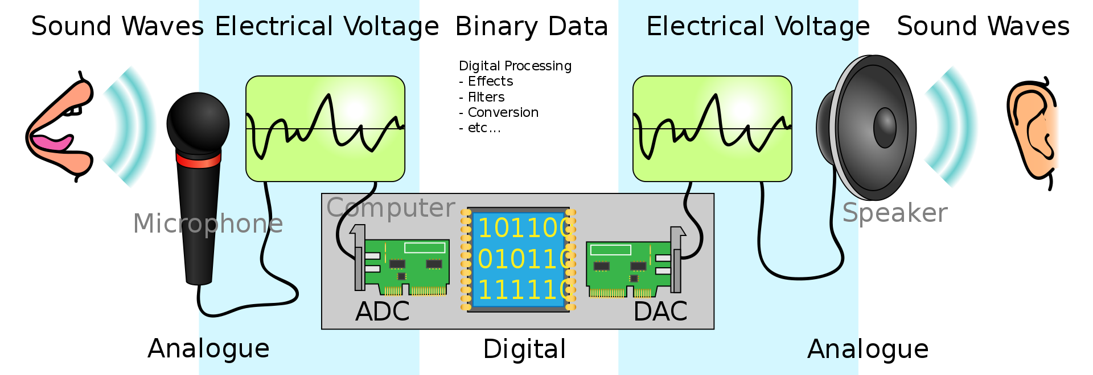
Electrical signals
Digital signal
Analog signal
Source

Slide 21
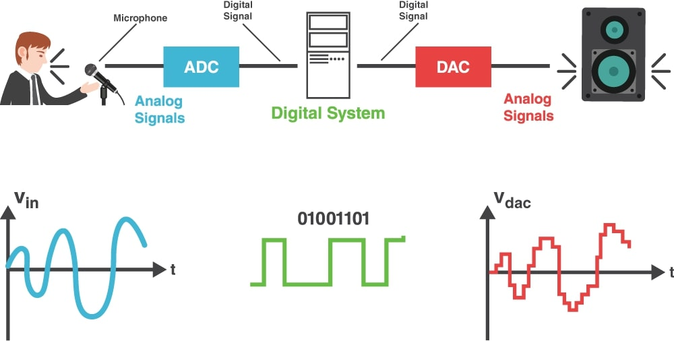
Electrical signals
Digital signal
Analog signal
Source

Slide 22
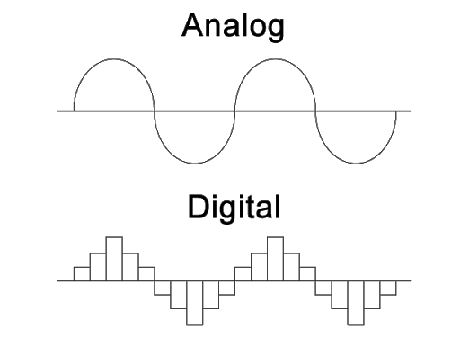
Data representation
Interpolation
Sampling
Quantization

Slide 23
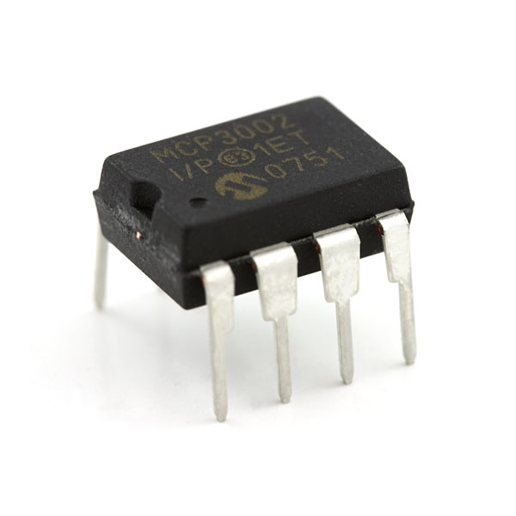

Converters
Electrical integrated solutions
Analog to Digital Converter (ADC)
Digital to Analog Converter (DAC)
Does the Arduino Uno board have converters integrated?

Slide 24
Arduino Uno DOES have an ADC integrated.
Arduino Uno DOES NOT have a DAC integrated.
How will we send analog signals?
use an external DAC
use the PWM pins

Slide 25
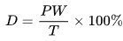
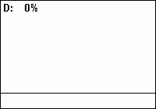
PWM (pulse-width modulation)
A duty cycle or power cycle is the fraction of one period in which a signal or system is active. Duty cycle is commonly expressed as a percentage or a ratio. A period is the time it takes for a signal to complete an on-and-off cycle. As a formula, a duty cycle (%) may be expressed as:
where D is the duty cycle, PW is the pulse width (pulse active time), and T is the total period of the signal. Thus, a 60% duty cycle means the signal is on 60% of the time but off 40% of the time. The "on time" for a 60% duty cycle could be a fraction of a second, a day, or even a week, depending on the length of the period.
Then, to calculate the output voltage, we have
V_dac = D * V
where D is the duty cycle and V is the signal Voltage
https://en.wikipedia.org/wiki/Duty_cycle

Slide 26

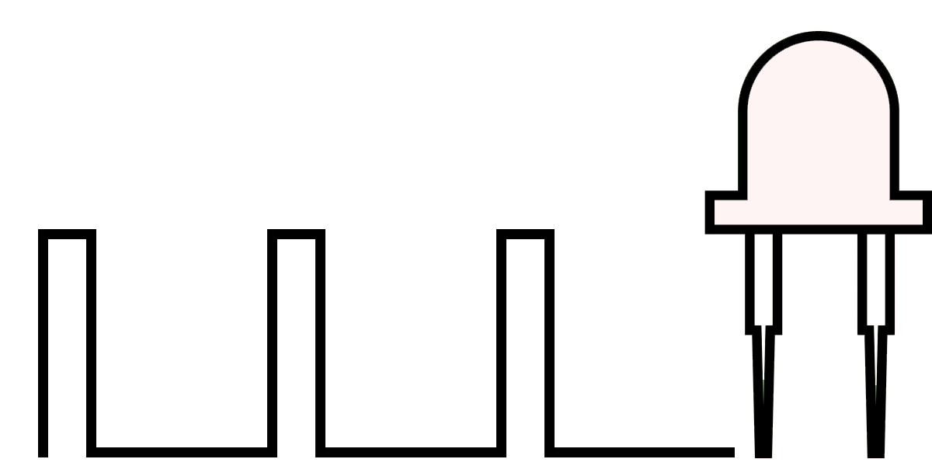
PWM (pulse-width modulation)
A technique for getting analog results with digital means
*gif works if you open the .ppt. It is possible to do so in the browser.

Slide 27
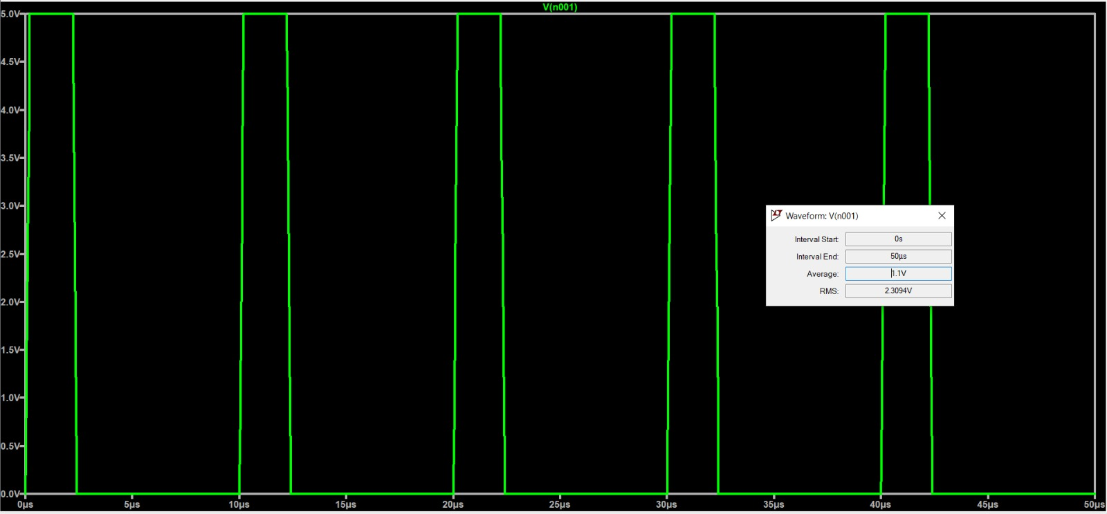
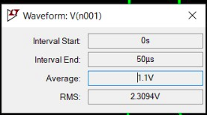
The voltage supply is 5V.
The duty cycle is 20% (Pulse width is 2u sec, and the period is 10u sec).
The output average should be 20*5/100 = 1 V.
Why is the average 1.1V ?

Slide 28
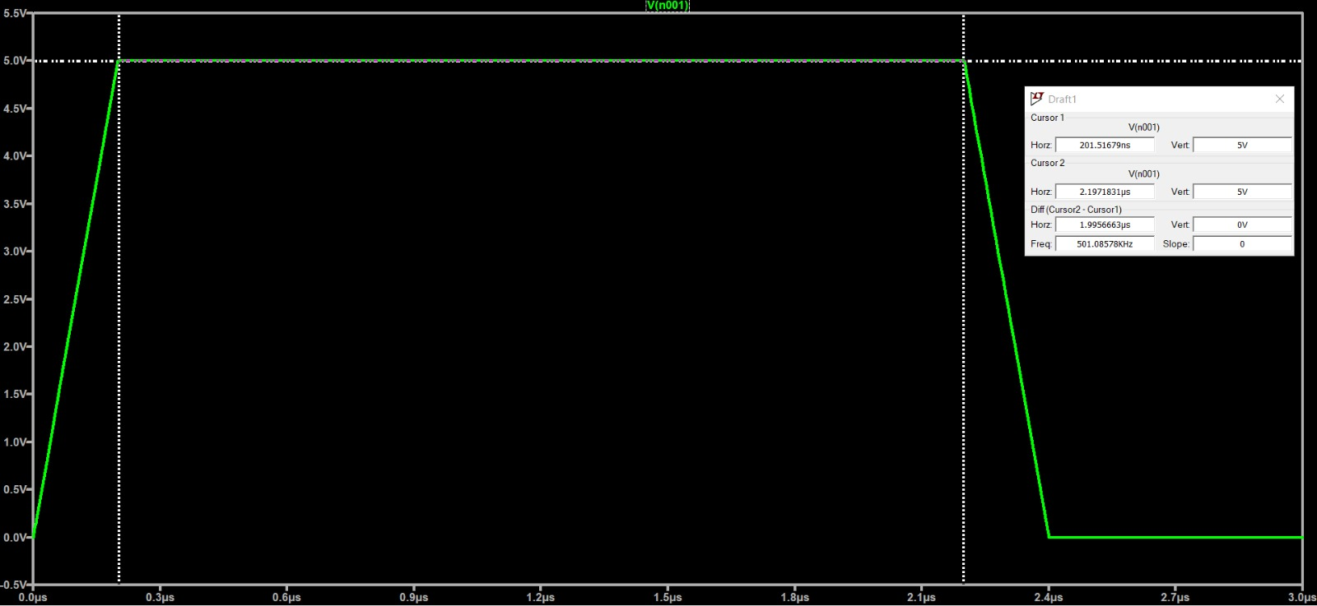
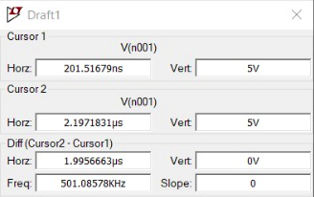
The rising and falling time are not 0.
The pulse is not a perfect square wave.
The areas under the slopes will be add to the average voltage.

Slide 29
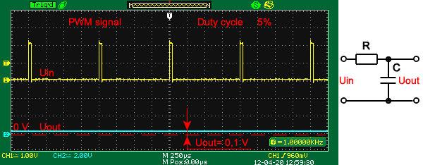
PWM (pulse-width modulation)
In practice, we use a RC low pass filter to convert the square wave into a continuous analog voltage (bottom line)
Detailed explanation
*gif works if you open the .ppt. It is possible to do so in the browser.

Slide 30
Logical interpretation
Digital signals have 2 states:
a HIGH/ON state
a LOW/OFF state
The state depends on the voltage received.
The levels of voltage correlated to a state are standardized.
Two of the most common standards are:
TTL Logic Levels
CMOS Logic Levels

Slide 31
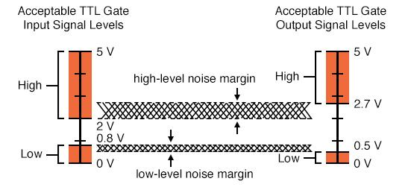
Source

Slide 32

Be careful!
It's important to know the voltage levels associated with the logical levels when you connect multiple devices.
Imagine you send a signal from A to B. The High value output might have a voltage under the threshold value for the logical High of B.
Moreover, if you go from 5V to 3.3 V, a step down circuit might be required. Check the datasheet of the device B in order to have the maximum accepted input voltage at most equal with the voltage generated by the High signal of device A.
Source

Slide 33
Coding style
For the matrix project, check github (work in progress, but it will be finished in time)
https://github.com/Irikos/arduino-style-guide

Slide 34
delay() vs millis()
delay(): Pauses the program for a specific time. It prevents the program from doing anything else until that particular task is completed.
millis(): Returns the current number of milliseconds since the Arduino started.
what’s the connection between them?

Slide 35
Attendance check
Who’s missing?

